Slide 1


DevOps internal course
Configuration management.
Ansible
Since 2002 on the market
22 years in Cybersecurity
350+ employees

Slide 2


Agenda
What is Ansible ?
Installing Ansible on Linux
Ansible Connecting to Linux Servers
Working with Inventory Files
Ansible Variable Handling
Launching Ad-Hoc Commands
Creating and Running Playbooks
Homework
21 years in Cybersecurity
350+ employees

Slide 3


What is Ansible ?
What is AWhat is Ansible?
Ansible is a tool for automating configuration management, software deployment, and IT environment orchestration.
It operates on an "agentless" principle, meaning it does not require a client installation on remote machines.
Programs similar to Ansible:
Puppet - a configuration management tool that operates on an agent-based principle.
Chef - Similar to Puppet but with a kitchen-themed terminology.
Where can Ansible be installed?
Linux - The primary platform for Ansible (Red Hat, CentOS, Ubuntu, etc.).
Windows - Can be used via WSL (Windows Subsystem for Linux) or for managing Windows servers remotely with Ansible.
MacOS - Supported through installation with Homebrew.
What is required for remote server management using Ansible?
For Linux - Port 22 (SSH) needs to be open for connecting to servers.
For Windows - Use WinRM (Windows Remote Management) or install OpenSSH for SSH connections
What is Ansible used for?
Automating software deployment.
Managing server and network configurations.
Orchestrating complex processes like CI/CD
21 years in Cybersecurity
350+ employees

Slide 4
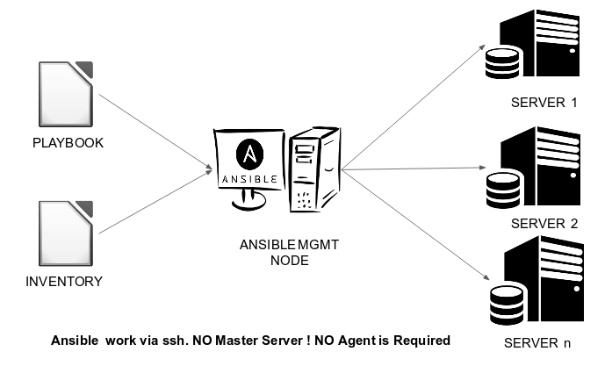
What is Ansible ? Operation diagram
21 years in Cybersecurity
350+ employees

Slide 5



Installing Ansible on Linux
Installing Ansible on specific operating systems: https://docs.ansible.com/ansible/latest/installation_guide/installation_distros.html#installing-ansible-on-specific-operating-systems
Installing Ansible on Ubuntu:
sudo apt update
sudo apt install software-properties-common
sudo add-apt-repository --yes --update ppa:ansible/ansible
sudo apt install ansible
ansible --version
21 years in Cybersecurity
350+ employees

Slide 6
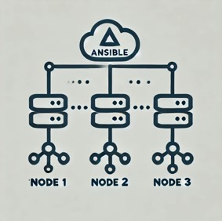
Ansible Connecting to Linux Servers
Create an inventory file for Ansible
hosts.ini
[staging]
test1 ansible_host=10.10.10.1 ansible_user=azureuser ansible_ssh_private_key_file=/opt/test/ansible/key/ansible_test.pem
[prod]
test2 ansible_host=10.10.10.2 ansible_user=azureuser ansible_ssh_private_key_file=/opt/test/ansible/key/ansible_test.pem
Create a basic Ansible configuration file
ansible.cfg
[defaults]
inventory = /opt/demo/ansible/hosts.ini
Check connections to servers using Ansible and ad-hoc command ping
ansible -i ./hosts.ini all -m ping
21 years in Cybersecurity
350+ employees

Slide 7

Working with Inventory Files
What is an Inventory File in Ansible?
An inventory file is a text file that contains a list of hosts (servers) managed by Ansible. It defines which servers or groups of servers will be targeted for tasks or playbooks. File Format: Inventory files are usually in INI or YAML format.
Inventory file in INI format
[staging]
test1 ansible_host=10.10.10.1 ansible_user=azureuser ansible_ssh_private_key_file=/opt/test/ansible/key/ansible_test.pem
[prod]
test2 ansible_host= 10.10.10.2 ansible_user=azureuser ansible_ssh_private_key_file=/opt/test/ansible/key/ansible_test.pem
Inventory file in YAML format
all:
children:
staging:
hosts:
test1:
ansible_host: 10.10.10.1
ansible_user: azureuser
ansible_ssh_private_key_file: /opt/test/ansible/key/ansible_test.pem
prod:
hosts:
test2:
ansible_host: 10.10.10.2
ansible_user: azureuser
ansible_ssh_private_key_file: /opt/test/ansible/key/ansible_test.pem
21 years in Cybersecurity
350+ employees

Slide 8
Ansible Variable Handling
Variables in Ansible
Variables allow you to store dynamic data that can be used in playbooks, roles, tasks, and templates in Ansible.
They enhance flexibility and reusability of configurations. Variables can contain parameters that change depending on the host, group, or execution context
Variables can be defined and used in: Playbooks: Inventory files, group_vars, roles
Moving variables from Inventory files to group_vars (special directory where you can store variables related to host groups)
Inventory file with variables
[staging]
test1 ansible_host=10.10.10.1
[prod]
test2 ansible_host=10.10.10.1
[envs:children]
staging
prod
[staging:vars]
ansible_user=azureuser
ansible_ssh_private_key_file=/opt/test/ansible/key/ansible_test.pem
Inventory file without variables
[staging]
test1 ansible_host=104.215.59.78
[prod]
test2 ansible_host=104.215.59.78
[envs:children]
staging
prod
21 years in Cybersecurity
350+ employees

Slide 9

Launching Ad-Hoc Commands
What are Ad-Hoc Commands in Ansible?
Ad-Hoc commands in Ansible are one-time commands used to execute simple tasks on remote hosts without creating a playbook.They are a quick way to perform tasks like checking connectivity, installing packages, changing configurations, or restarting services.
Check Host Availability: ansible all -m ping
Gather System Information: ansible all -m setup
Check System Uptime: ansible all -m shell -a "uptime“
Copy a File: ansible all -m copy -a "src=./test.txt dest=/opt" –b
Display File Contents: ansible all -m shell -a "cat /opt/test.txt“
Delete a File: ansible all -m file -a "path=/opt/test.txt state=absent" –b
List Directory Contents: ansible all -m shell -a "ls /opt/"
21 years in Cybersecurity
350+ employees

Slide 10
Creating and Running Playbooks
What is a Playbook in Ansible?
A Playbook is a YAML file that defines a set of tasks to be executed on remote hosts.
Playbooks describe automation workflows in a declarative way, making them easy to read and maintain.
They consist of plays, which define what tasks to run, on which hosts, and in what order.
Ansible playbook: Test connection to the servers
---
- name: Test connection to the servers
hosts: staging
become: yes
tasks:
- name: Run the ping command
ping:
- name: Run uptime command
shell: uptime
register: uptime_out
- name: Show uptime output
debug:
var: uptime_out
Ansible playbook: Install Web Server
---
- name: Install Web Server
hosts: all
become: yes
tasks:
- name: Install server
apt: name=apache2 state=present
- name: Start WEB and enable it
service: name=apache2 state=started enabled=yes
21 years in Cybersecurity
350+ employees

Slide 11
Creating and Running Playbooks
Ansible playbook: Install and configure Web Server
---
- name: Install and configure Web Server
hosts: all
become: yes
vars:
source: /opt/demo/ansible/index.html
destin: /var/www/html
tasks:
- name: Install server
apt: name=apache2 state=present
- name: Configure server
copy: src={{ source }} dest={{ destin }} mode=0555
notify: restart
- name: Start WEB and enable it
service: name=apache2 state=started enabled=yes
handlers:
- name: restart
service: name=apache2 state=restarted
21 years in Cybersecurity
350+ employees

Slide 12

Homework
1. Prepare a playbook that executes the “ls /etc” command, saves the output as a variable, and displays it.
2. Prepare a playbook that will install Docker on Azure VM
3. Prepare a playbook that installs NGINX and copies a simple index.html file with the text "Ansible the best"
4. Save playbooks to your GitHub repo
21 years in Cybersecurity
350+ employees

Slide 13

Any questions?
21 years in Cybersecurity
350+ employees

Slide 14





Thank you!
If you have any questions , please contact us at
info@apriorit.com
www.apriorit.com
Follow us on social media:
www.linkedin.com/company/apriorit
www.twitter.com/Apriorit
Q
www.softwareengineeringblog.quora.com
www.facebook.com/apriorit
21 years in Cybersecurity
350+ employees

